Slide 1
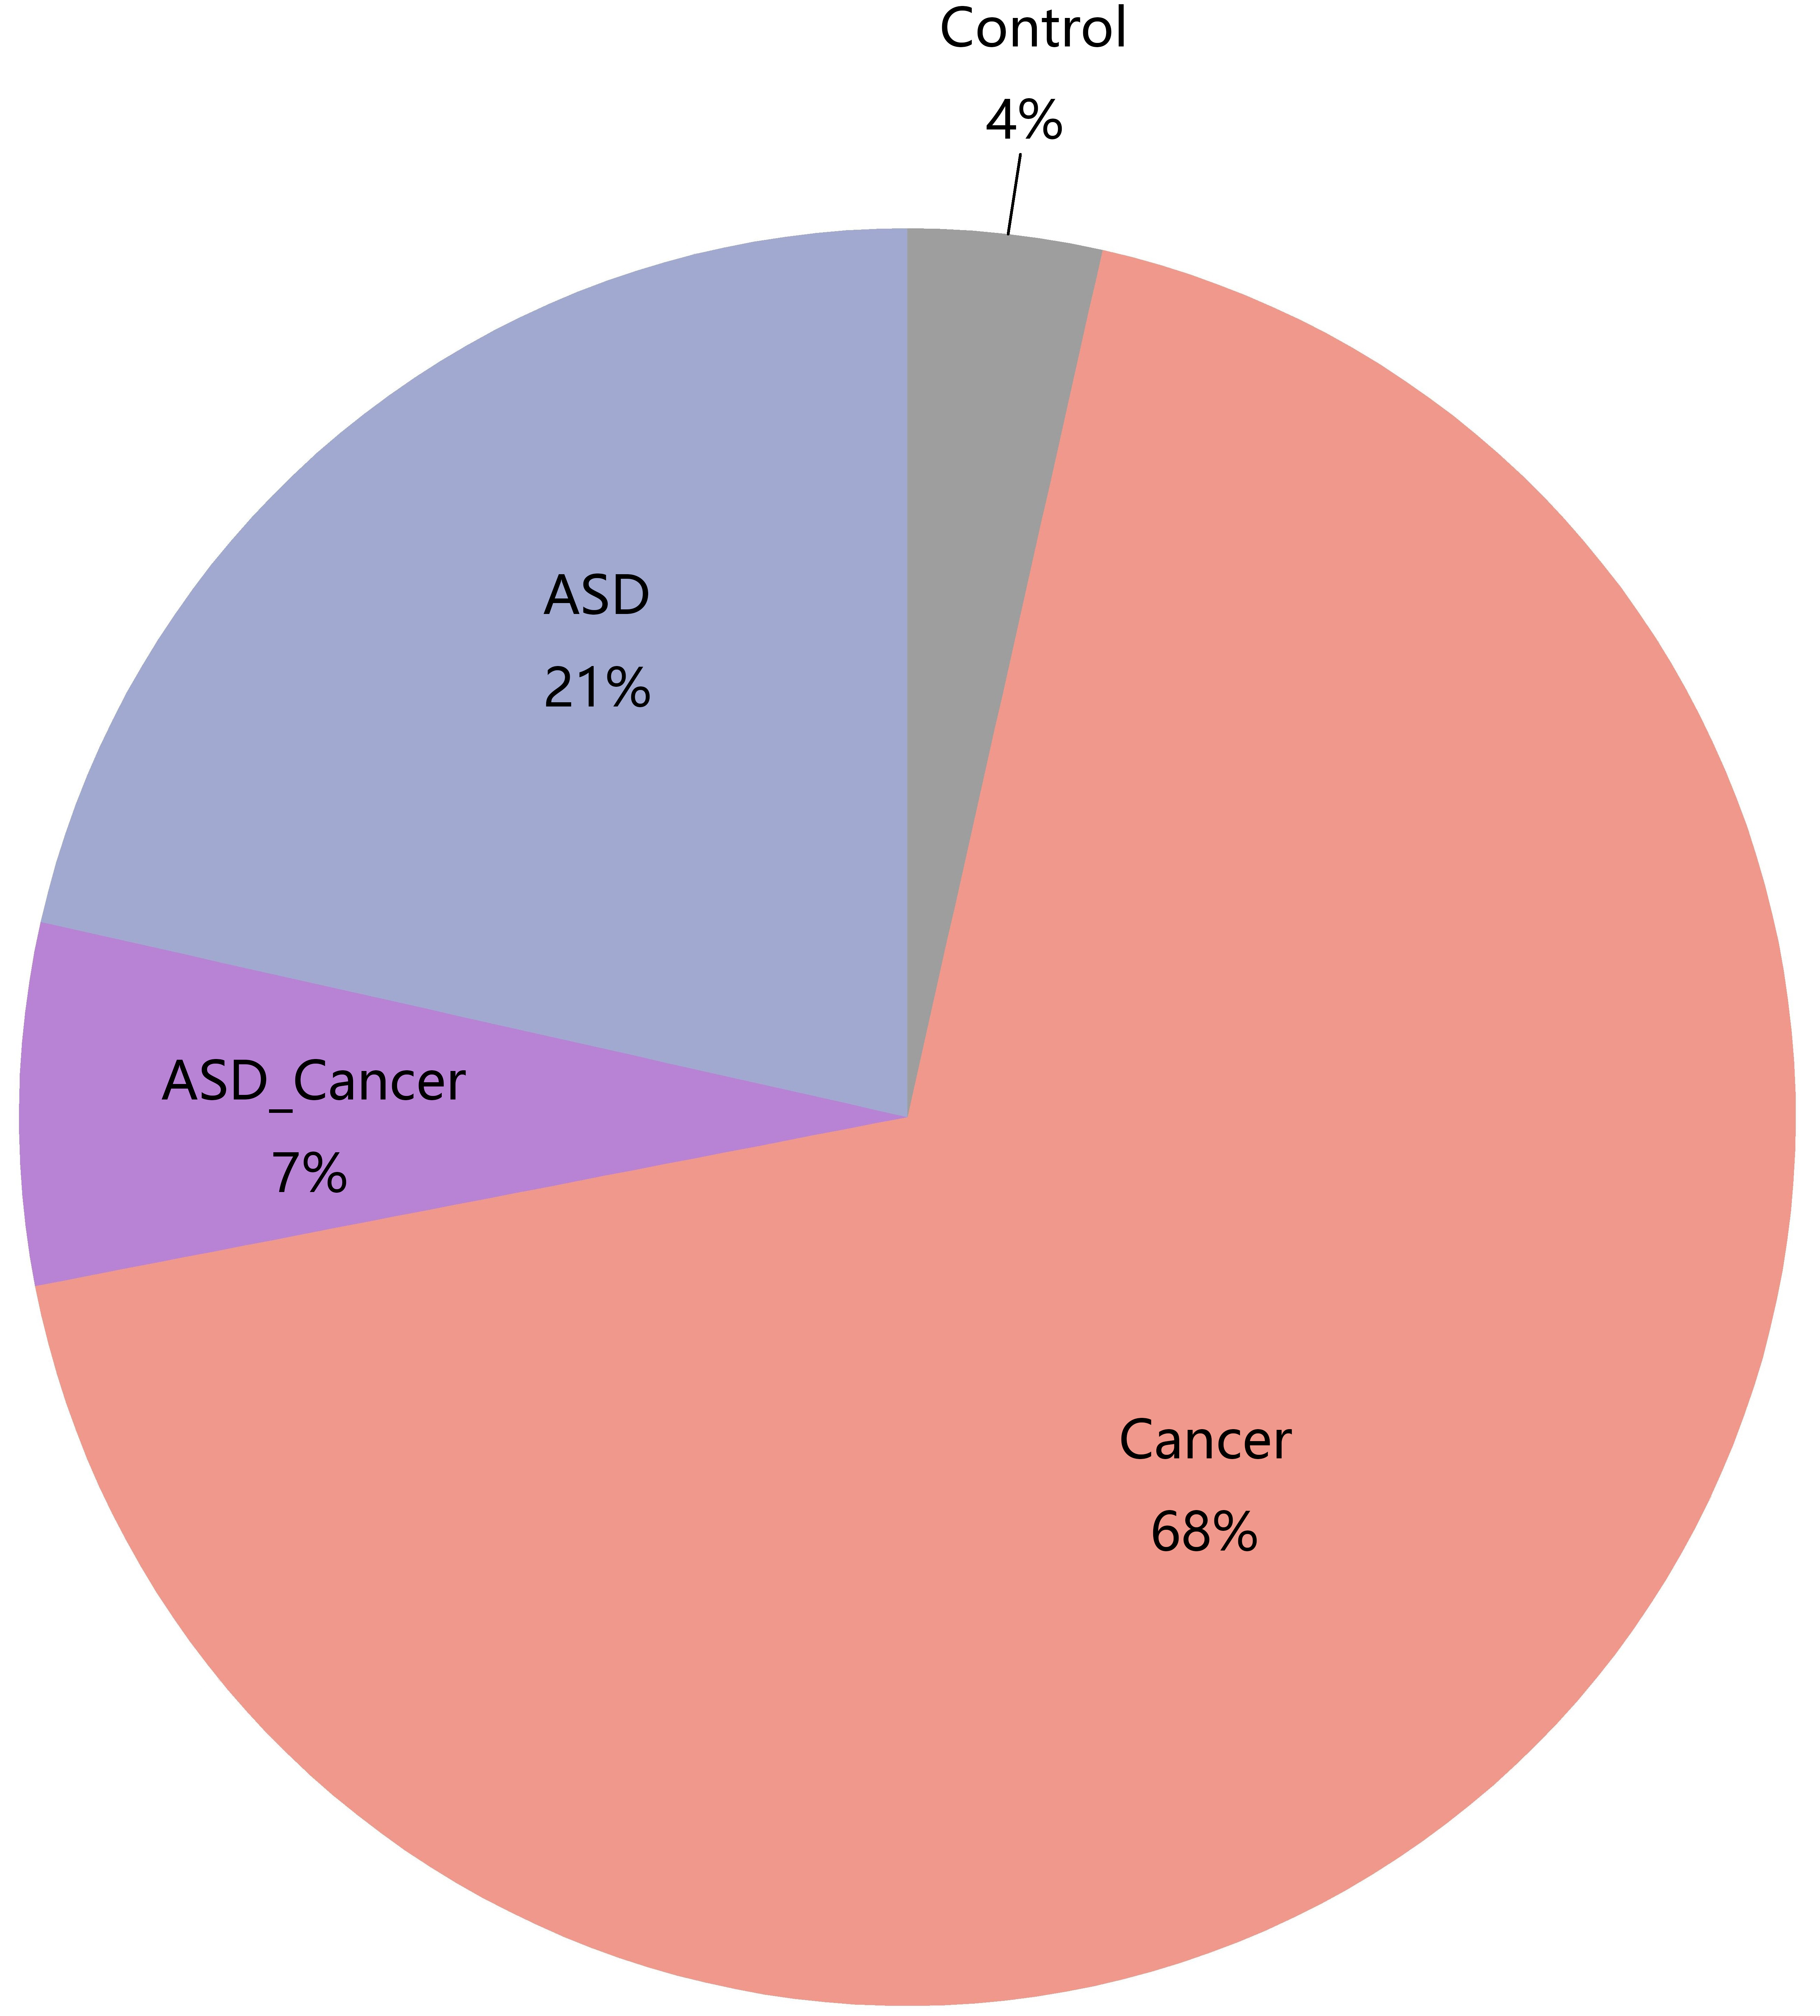
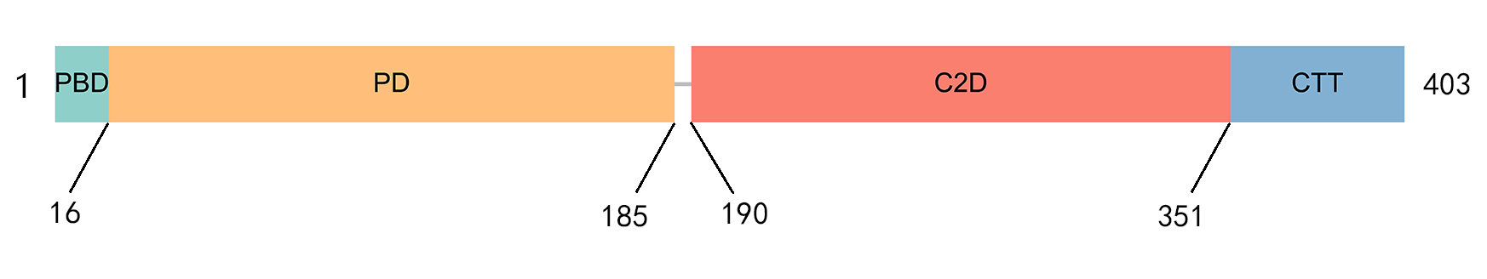
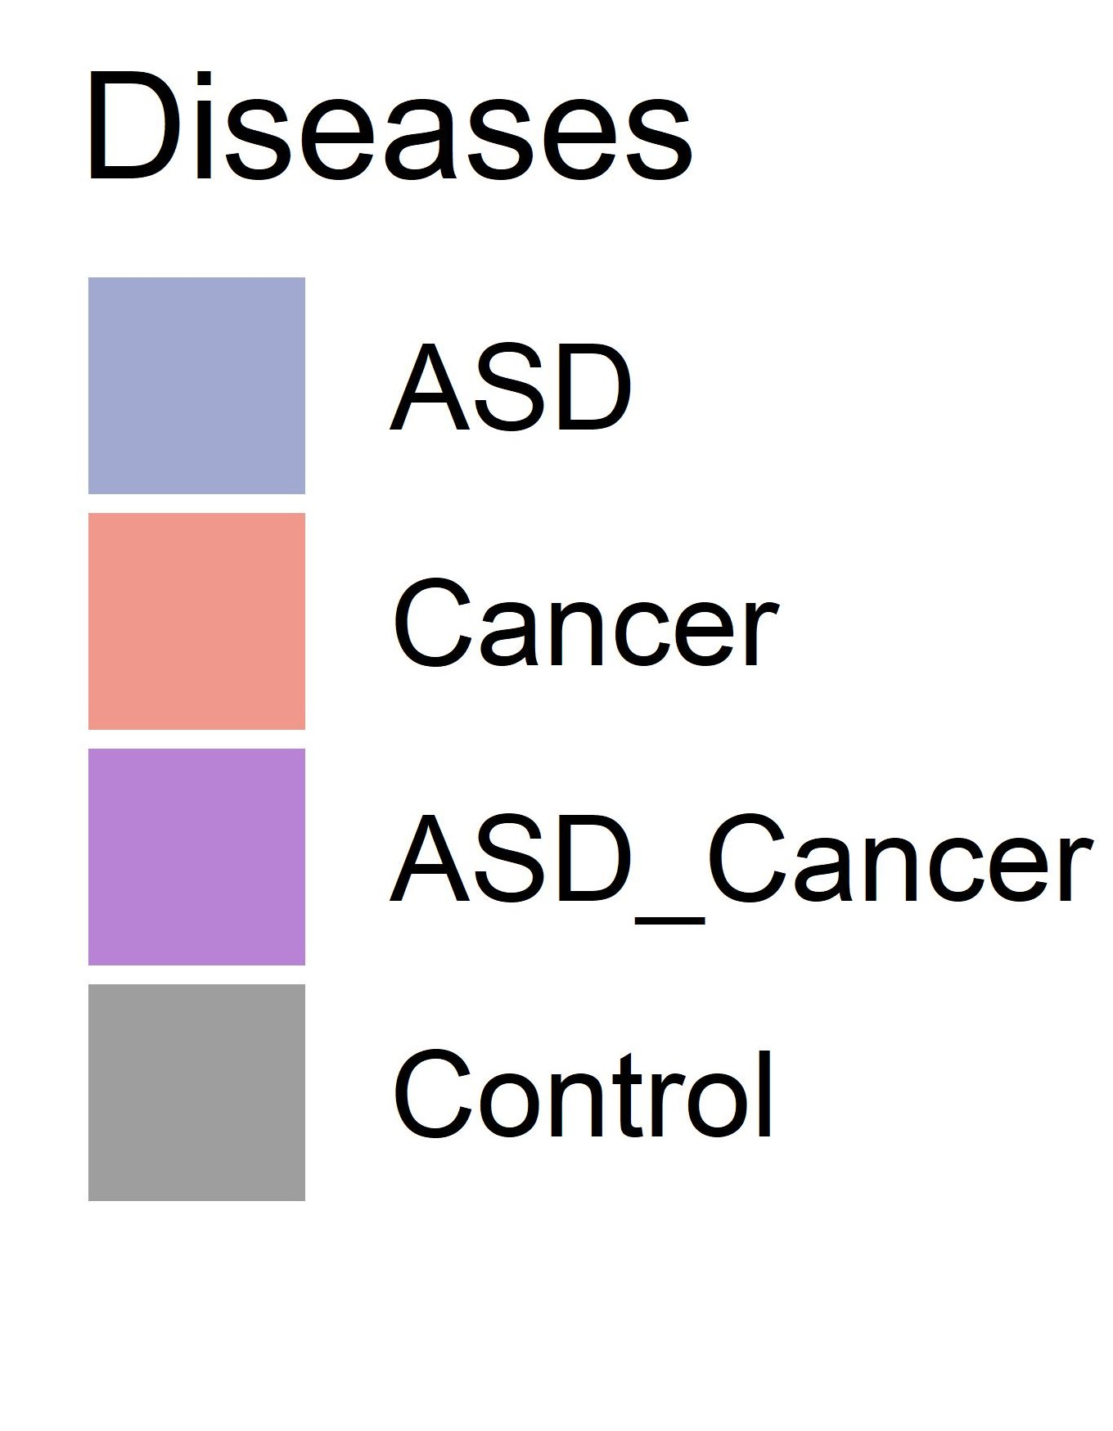
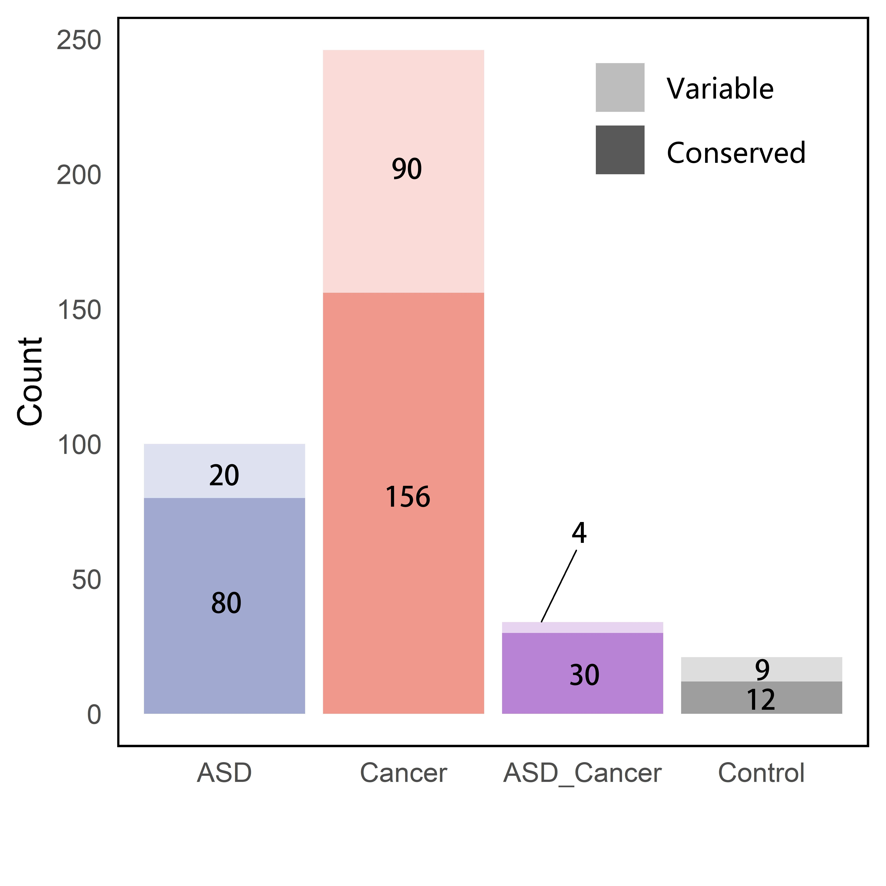
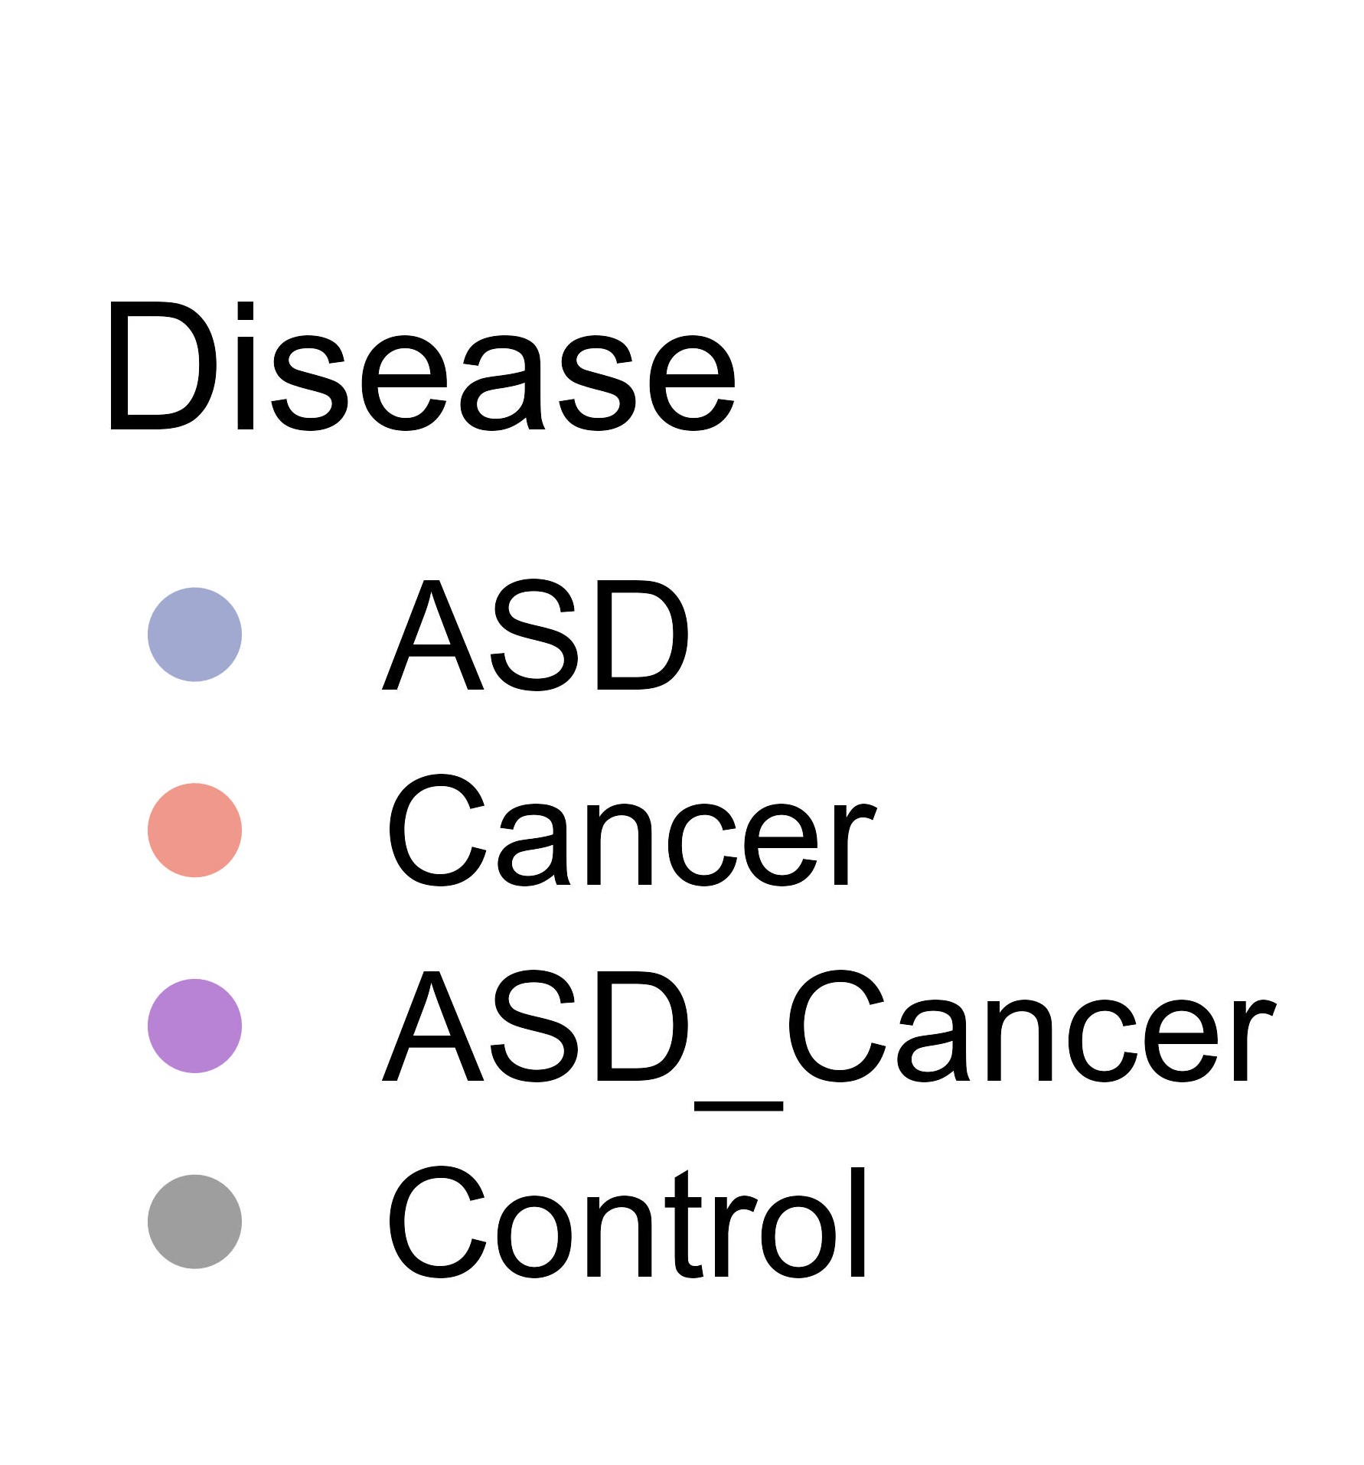
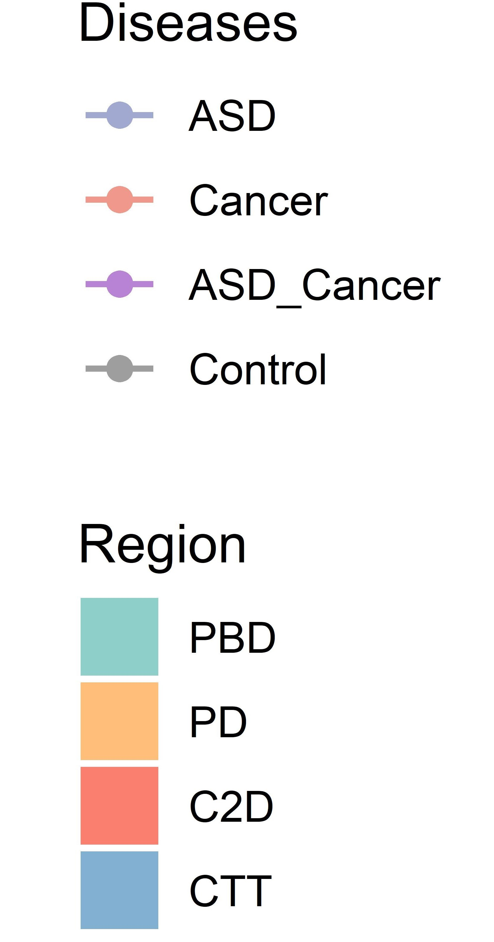
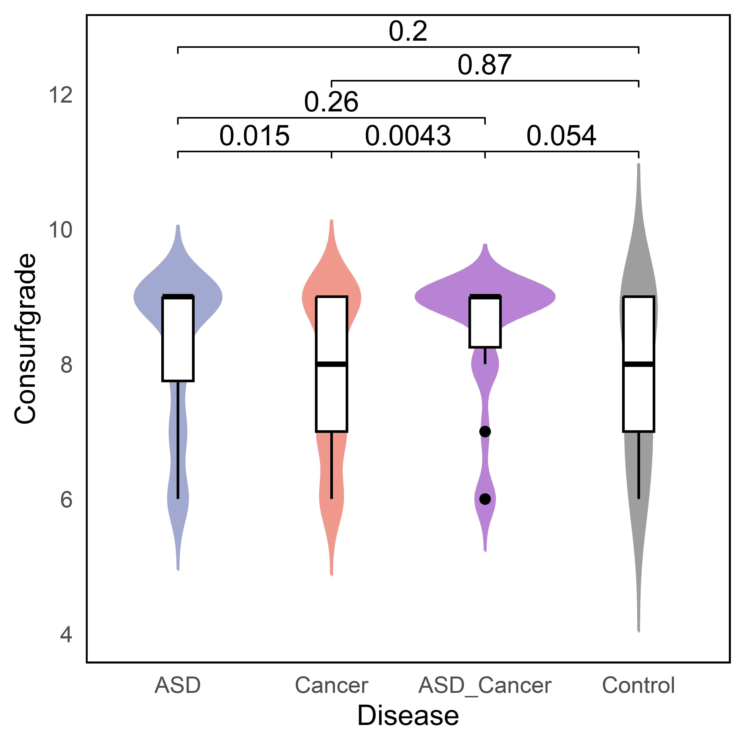
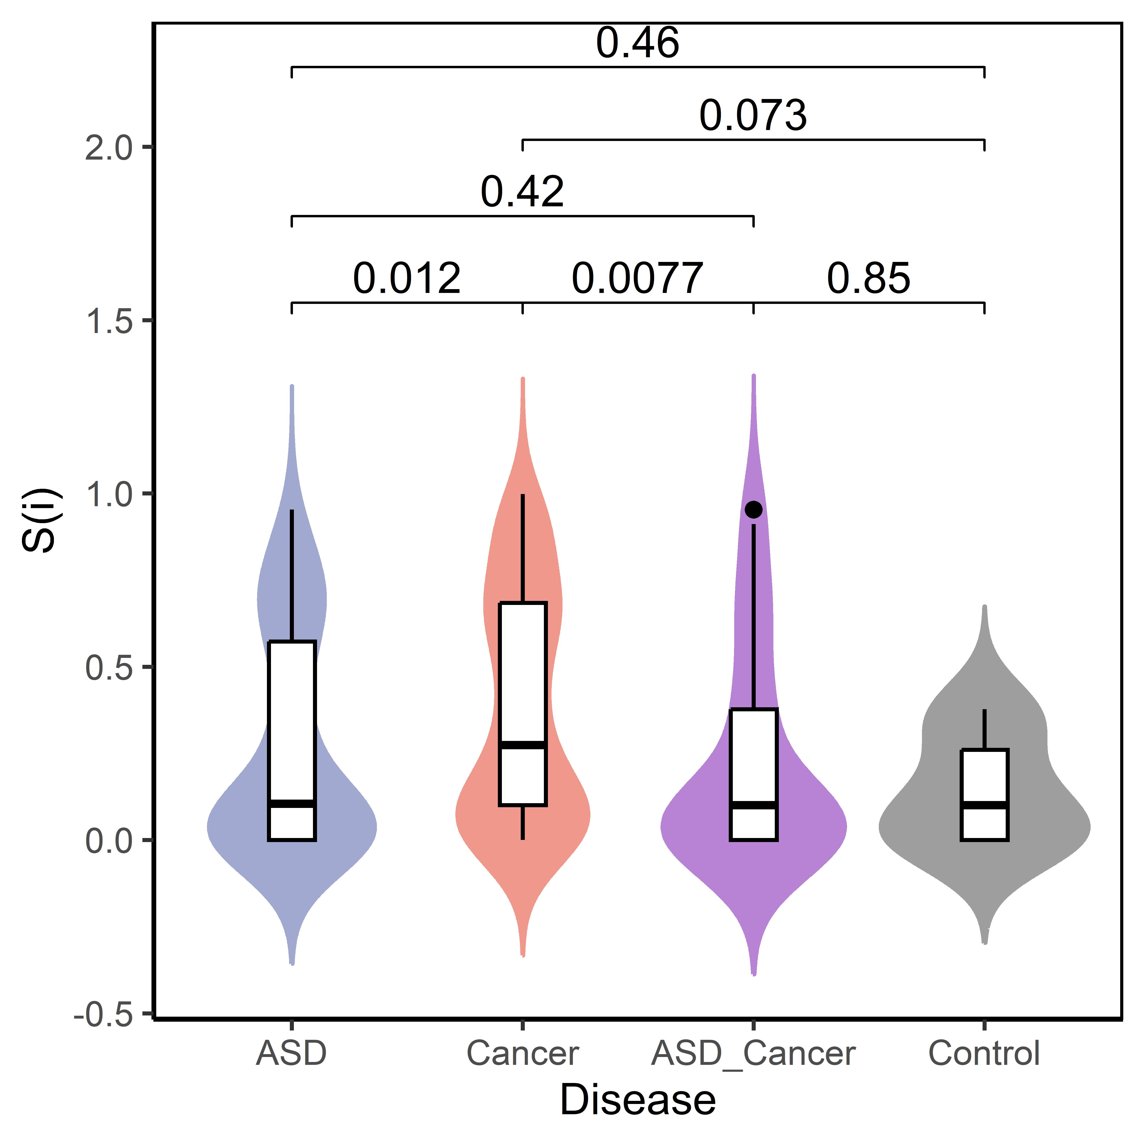
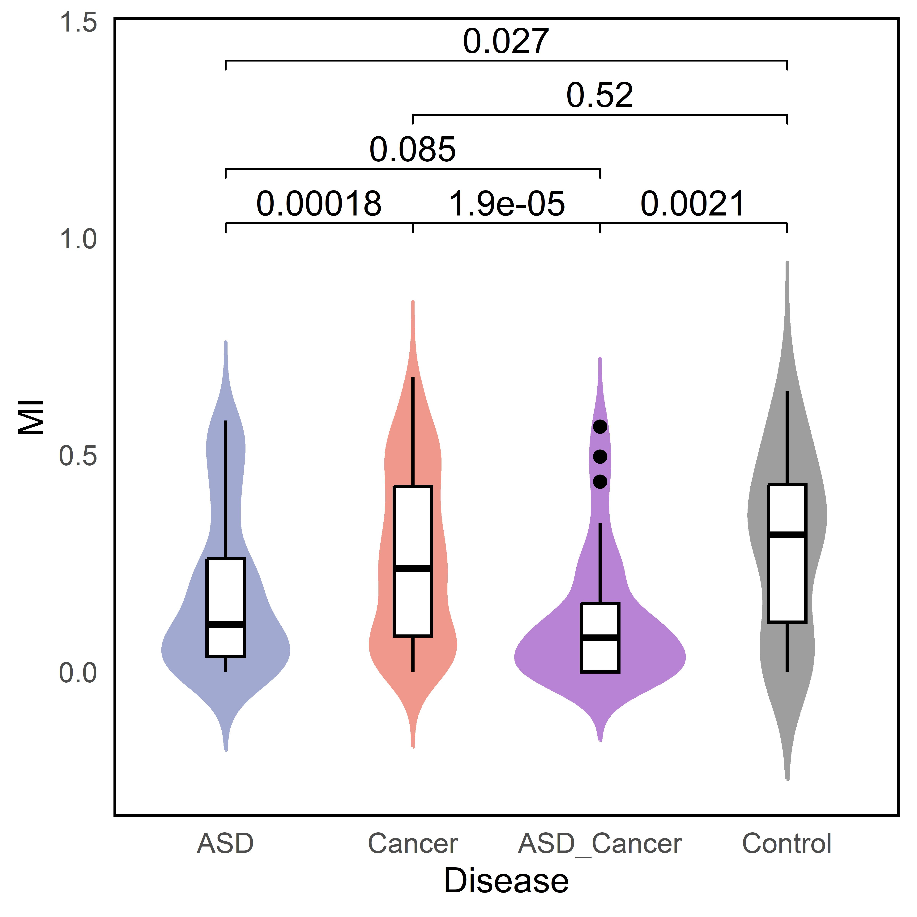
A
B
C
D
F
H
E
G
I
Notes:
Note: four colors are used for representing diseases and another four colors are used for representing protein structural domians.

Slide 2
Notes:
Pie chart

Slide 3
Figure A
The composition and statistics of PTEN mutations based on four categories: ASD, cancer, both ASD and cancer, and control group.
A total of 427 mutations related to cancer (represented by the red portion) were collected, accounting for 68% of all mutations. A total of 134 mutations related to ASD (represented by the blue portion) were collected, accounting for 21% of all mutations. A total of 141 mutations related to both cancer and ASD (represented by the purple portion) were collected, accounting for 7% of all mutations. A total of 22 benign mutations related to PTEN mutations (represented by the gray portion) were collected, accounting for 4% of all mutations.

Slide 5
Figure B
Distribution ranges of the four structural domains on the PTEN protein. The four colors represent the four protein structural domains: PBD (green): 1-15aa; PD (yellow): 16-185aa; C2D (red): 190-350aa; CTT (blue): 351-403aa.

Slide 6
Notes:
Mutation distribution

Slide 7
Figure C
Distribution and frequency of PTEN mutations in four protein structural domains.
The x-axis represents the PTEN sequence positions (1-403aa), and the y-axis represents the mutation frequency at each corresponding position based on the collected data. The four colors represent the four protein structural domains: PBD (green): 1-15aa; PD (yellow): 16-185aa; C2D (red): 190-350aa; CTT (blue): 351-403aa.

Slide 8
Notes:
Conservation distributiion

Slide 9
Figure D
Conservation distribution of mutation sites in the four PTEN related categories.
Setting a default conservation score >5, the 427 cancer related mutations include 246 amino acid positions, with 156 of them considered as conserved. The 134 ASD related mutations include 100 amino acid positions, with 80 of them considered as conserved. The 41 ASD and cancer related mutations include 34 amino acid positions, with 30 of them considered as conserved. The 22 mutations of the control group include 21 amino acid positions, with 12 of them considered as conserved.

Slide 11
Figure E
Comparison of consurfgrade values among the four categories related to PTEN. Statistical significance was determined using the Wilcoxon signed-rank test.

Slide 13
Figure F
Distribution plot of entropy values (S(i)) calculated for each residue in PTEN mutations.

Slide 15
Figure G
Comparison of entropy values (S(i)) among the four categories related to PTEN. Statistical significance was determined using the Wilcoxon signed-rank test.

Slide 17
Figure H
Distribution plot of coevolutionary values (MI) calculated for each residue in PTEN mutations.

Slide 19
Figure I
Comparison of coevolutionary values (MI) among the four categories related to PTEN. Statistical significance was determined using the Wilcoxon signed-rank test.

